Slide 1


Project Title Iris Flower Classification
Name: NIRANJAN KUMAR
Roll no- 2312res418
Date: 21 August 2025

Slide 2

Problem Statement
The iris flower, scientifically known as Iris, is a distinctive genus of flowering plants. Within this genus, there are three primary species: Iris setosa, Iris versicolor, and Iris virginica. These species exhibit variations in their physical characteristics, particularly in the measurements of their sepal length, sepal width, petal length, and petal width.
Objective
The objective of this project is to develop a machine learning model capable of learning from the measurements of iris flowers and accurately classifying them into their respective species. The model's primary goal is to automate the classification process based on the distinct characteristics of each iris species.

Slide 3
Project Details
Iris Species: The dataset consists of iris flowers, specifically from the species setosa, versicolor, and virginica.
Key Measurements: The essential characteristics used for classification include sepal length, sepal width, petal length, and petal width
Machine Learning Model: The project involves the creation and training of a machine learning model to accurately classify iris flowers based on their measurements

Slide 4
Dataset Snapshot (first 5 rows)
Sepal length (cm) | Sepal width (cm) | Petal length (cm) | Petal width (cm)
5.1 | 3.5 | 1.4 | 0.2
4.9 | 3.0 | 1.4 | 0.2
4.7 | 3.2 | 1.3 | 0.2
4.6 | 3.1 | 1.5 | 0.2
5.0 | 3.6 | 1.4 | 0.2

Slide 5
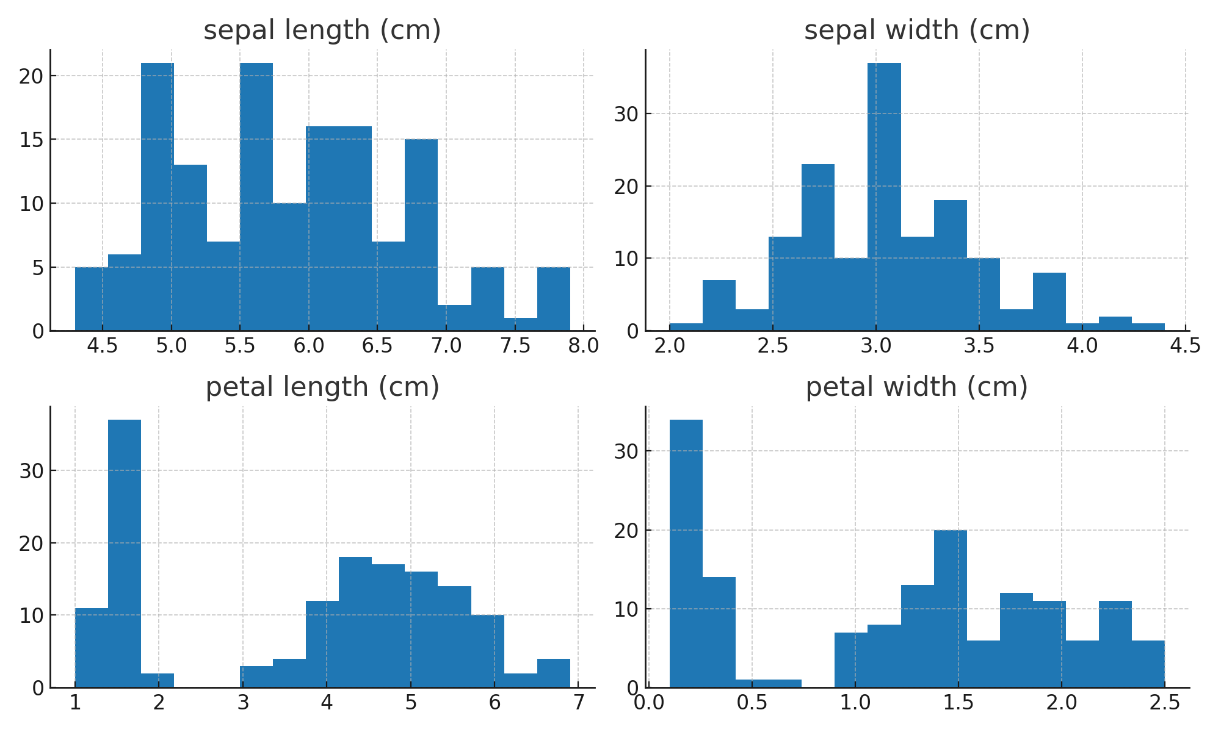
Feature Distributions

Slide 6
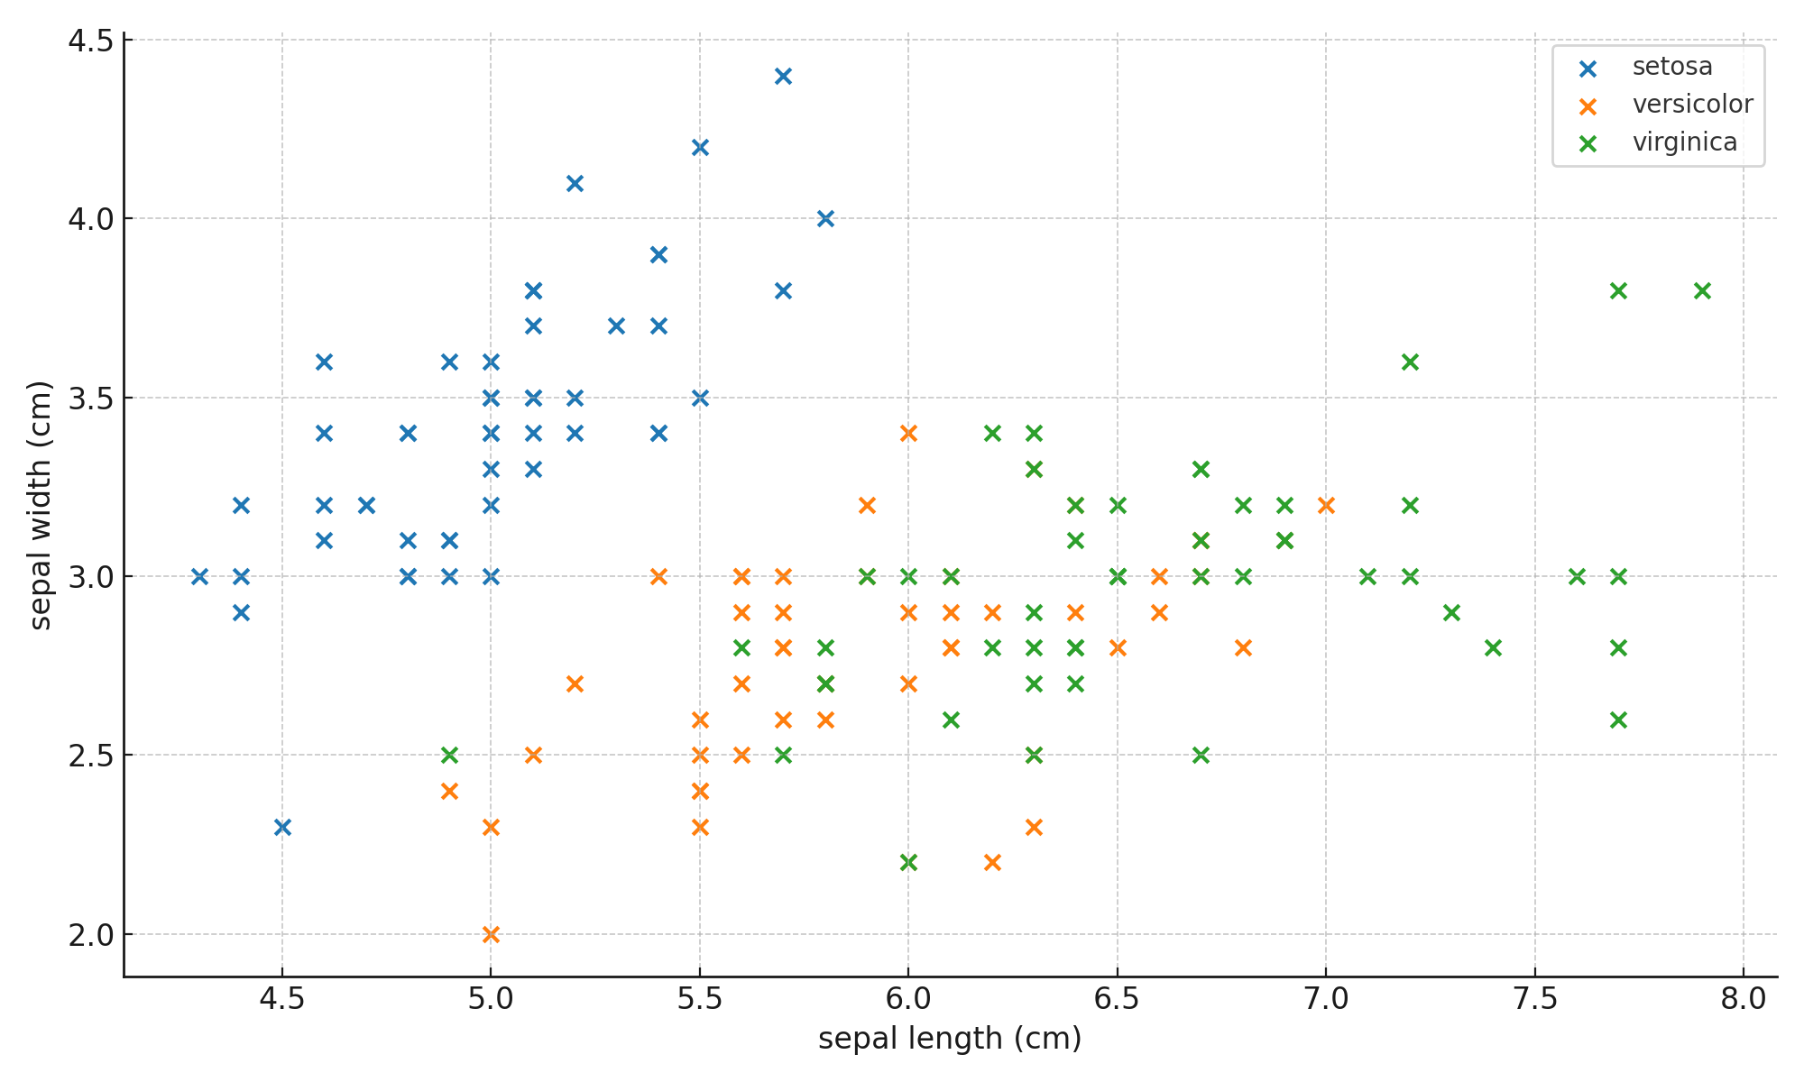
Sepal Analysis (Length vs Width)

Slide 7
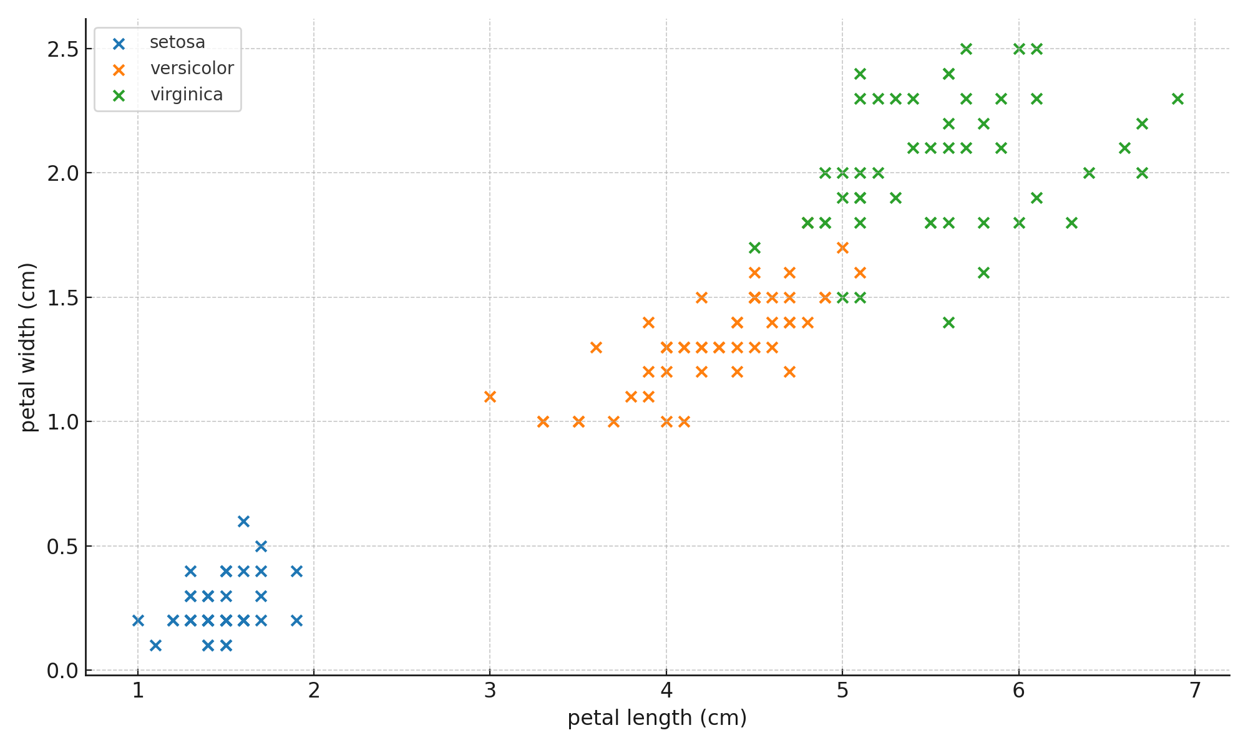
Petal Analysis (Length vs Width)

Slide 8

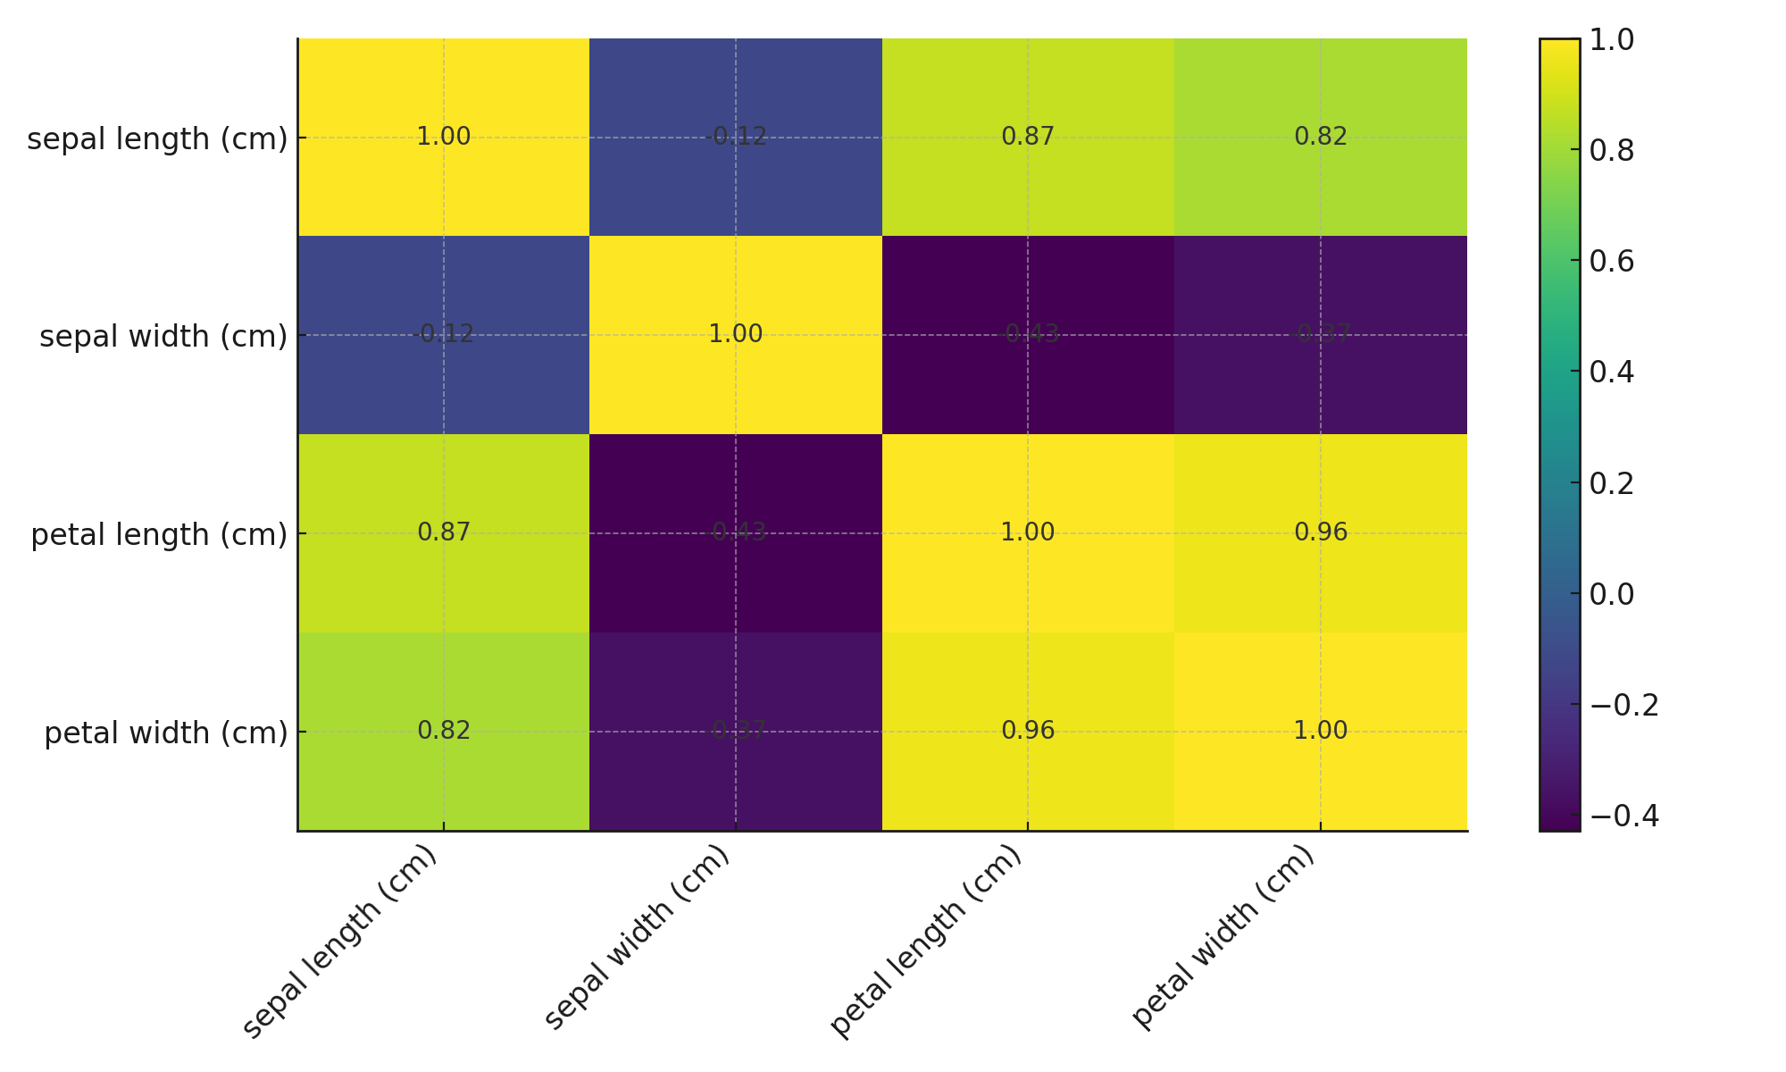
Correlation Heatmap
Your ability to communicate effectively will leave a lasting impact on your audience
Effectively communicating involves not only delivering a message but also resonating with the experiences, values, and emotions of those listening

Slide 9
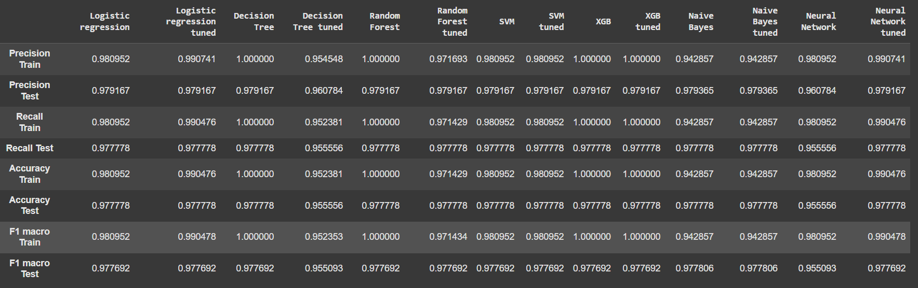
Model Building Process
Train/test split: 80/20 with stratification
Scaling applied for LR/SVM
Models: Logistic Regression, Decision Tree, Random Forest, SVM (RBF), Gradient Boosting (XGBoost alternative)
Metrics: Accuracy, Precision, Recall, F1 (macro)
Effective body language enhances your message, making it more impactful and memorable.
Meaningful eye contact
Purposeful gestures
Maintain good posture
Control your expressions

Slide 10
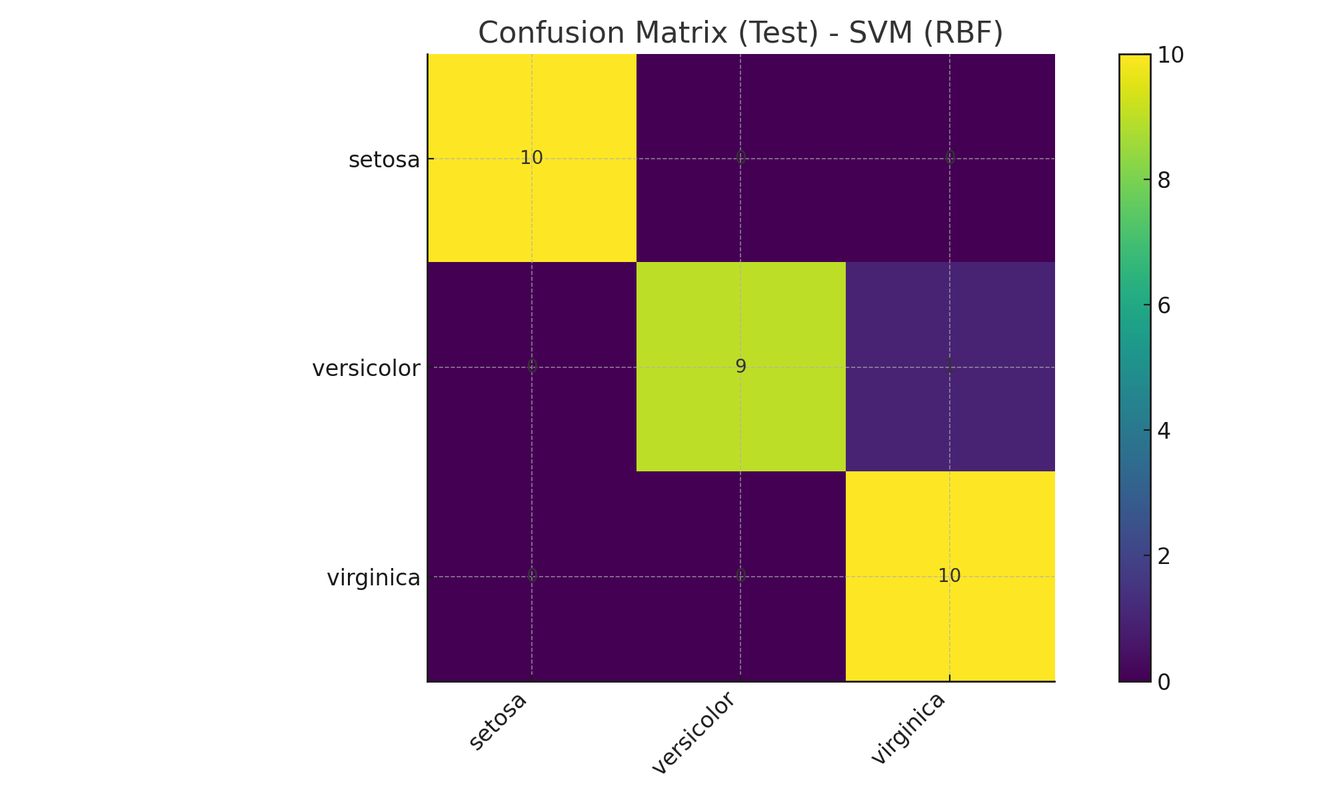
Confusion Matrix (Test) - SVM(RBF)

Slide 11
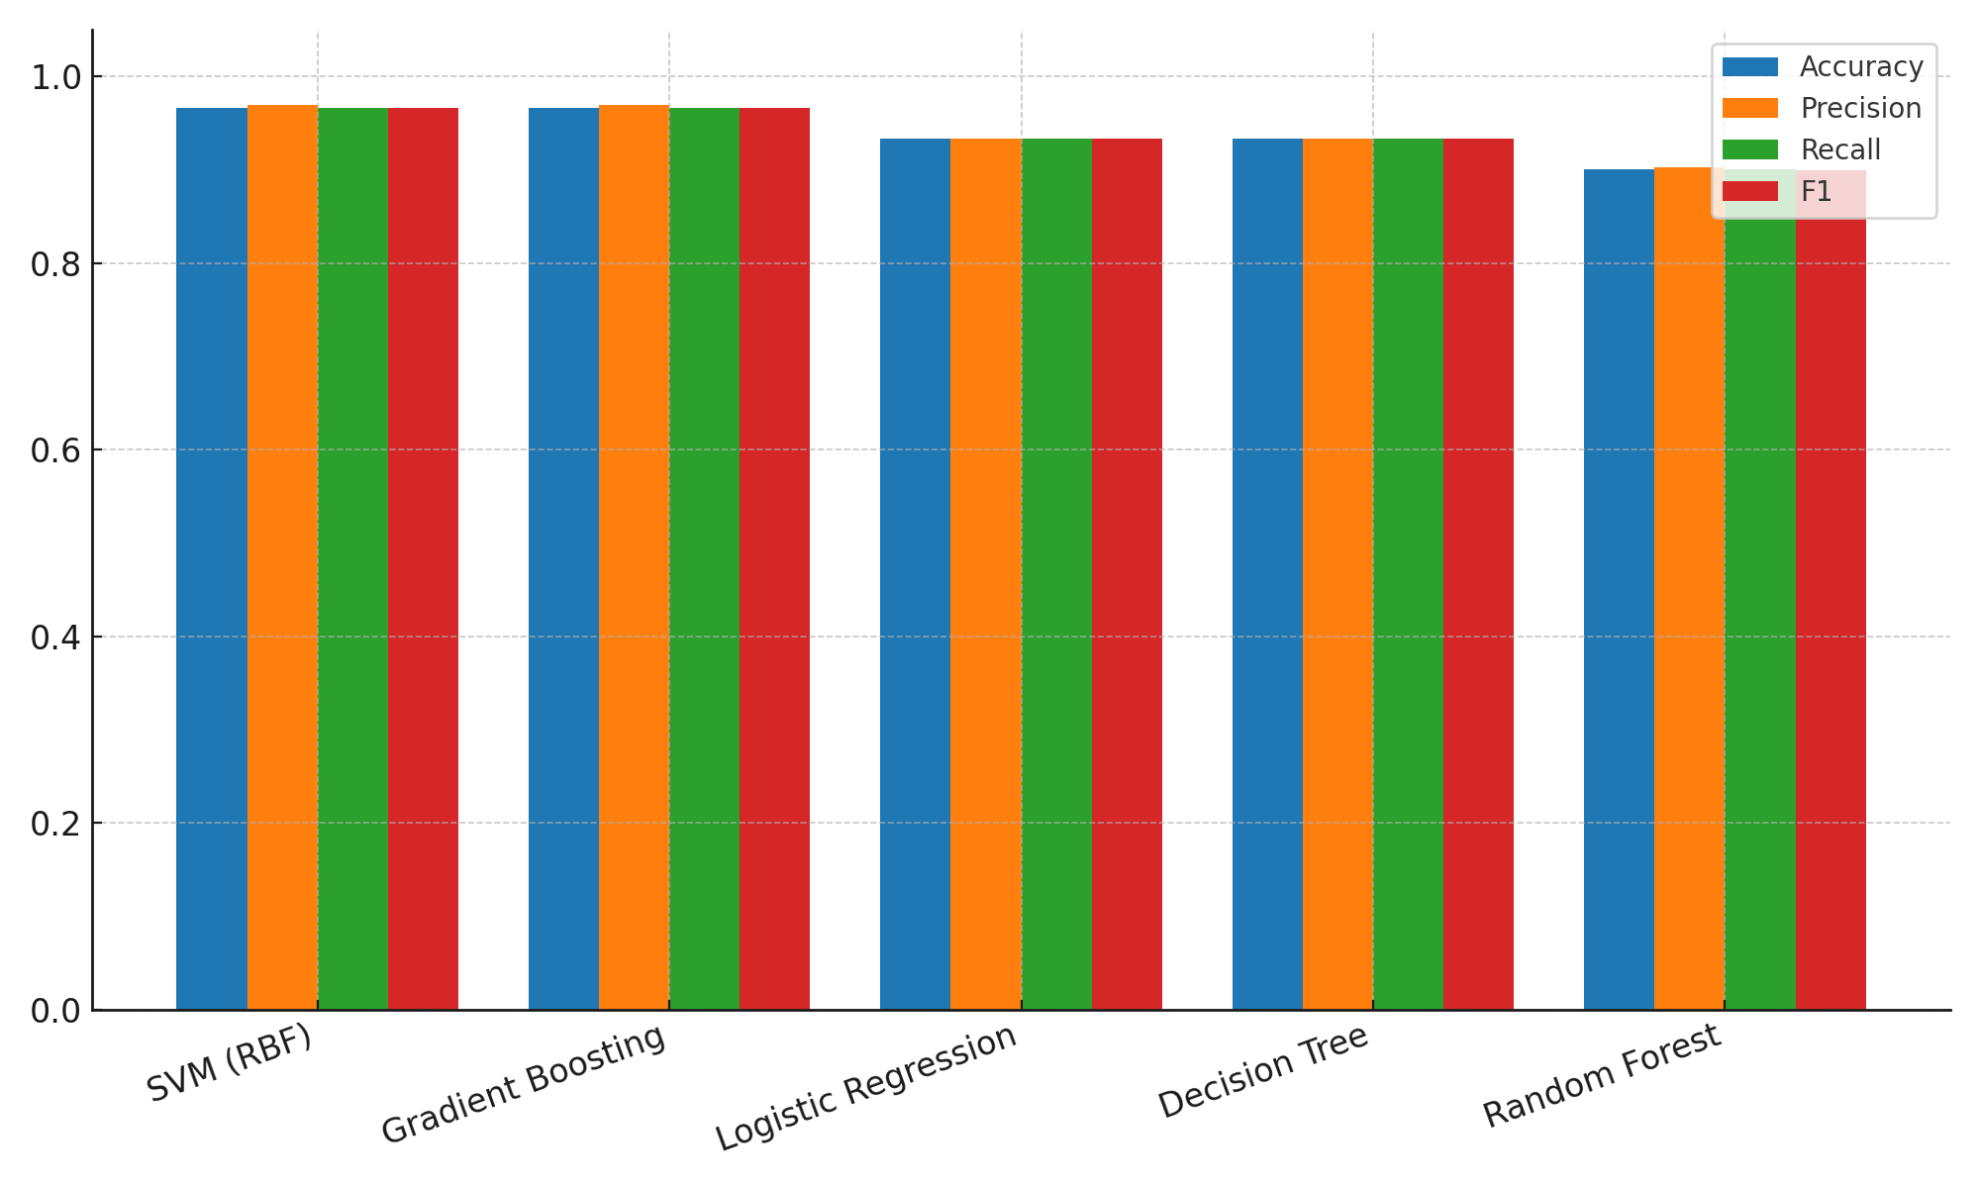
Model Comparison: Accuracy, Precision, Recall, F1

Slide 12
Insights & Results
Best Model: SVM (RBF) (Accuracy: 96.67%, F1: 96.66%)
Petal features show strongest separability; Setosa is linearly separable.
Tree ensembles perform robustly without scaling; LR/SVM benefit from scaling.

Slide 13
Future Scope
Add more flower species and real-world field data.
Hyperparameter tuning and cross-validation.
Export model and deploy a simple web app for demo.
Conclusion
ML can classify Iris species with high accuracy.
Comparative evaluation helps select a reliable model.
Visualizations confirm strong feature patterns, especially in
petal measurements.

Slide 14
Thank you

